Slide 1
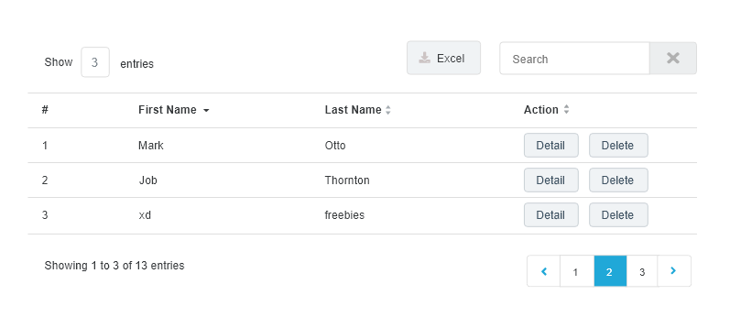
Table

Slide 2


Button
Use for research, register
Use for setting, link in title card

